Slide 1


Work Flow Process for Central Data Repositories and Single Sign on through Unified Communication System
First Workshop of KRISHI Nodal Officers
Knowledge based Resources Information Systems Hub for Innovations in Agriculture
(ICAR Research Data Repository for Knowledge Management)
http://krishi.icar.gov.in
August 04-05, 2015
Venue: AP Shinde Symposium Hall, NASC Complex, New Delhi
ICAR-Indian Agricultural Statistics Research Institute, New Delhi

Slide 2
Content:
ICAR-Data Centre
Unified Communication Services
Web Hosting Services
KRISHI Portal Services
Access of KRISHI through Single Sign On using Unified Communication System
Roll based access to applications
Work-Flow Process of applications
Dissemination of Information & MIS

Slide 3
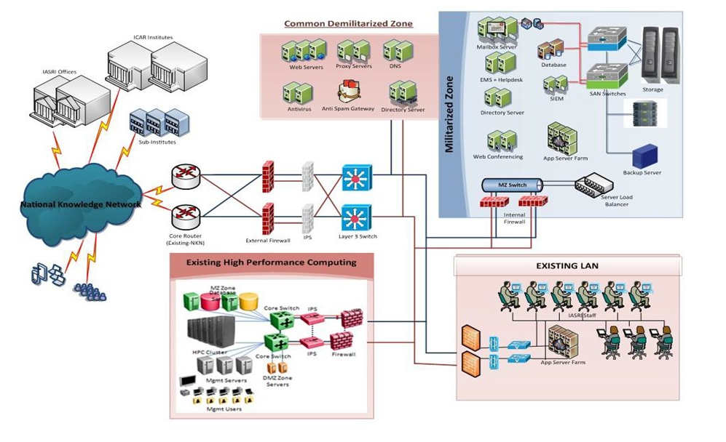
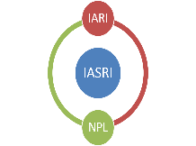
ICAR-Data Centre
Established in June 2014 under NAIP Component-1 at ICAR-IASRI

Slide 4
Data Centre Facilities
Data Centre has total 12 racks, 150 KVA modular UPS, Redundant Chiller based Colling.
The solution has total 448 core computing.
The Solution has Virtualisation of cross the platform. i.e. Windows, Linux etc.
Directory Solution, Single sign on for email, Lync and AD
Microsoft Exchange 2013, a worldwide leader of corporate unified communications, with 25000 mail boxes and 15000 Lync licenses.
150 TB raw Storage, expandable up to 480 TB.
All the cross platform of Security devices. i.e. MacAfee IPS, Check Point Perimeter firewall, FortiGATE Internal Firewall, Web Proxy

Slide 5
LAN security and user based internet access. It is very essential to stop the anti-nation/anti-social activities
Log management as per IT policy of Govt. of India
There are 67 servers including 28 Physical & 39 Virtual servers, all servers are located at ICAR- Data Centre at IASRI.
Have Microsoft Windows Server 2008R2 & 2012 data centre, standard version and Linux RHEL 7 servers installed.
Windows Hyper-V and Linux KVM is configured for server Virtualization.

Slide 6
Web Hosting Facilities
Hosting of Website/Applications on
  Windows Platform
    Windows 2012 OS,
    MS-SQL Server 2012,
    IIS
  Open Source Platform
    Linux
    MySQL
    APACHE
Storage Area Network (SAN) for storing Application & Database
Back-up on Tape Drive
Virtual Server for Web, Application, Databases
Co-location of Servers

Slide 7
Proposed Strengthening of Infrastructure: Servers, Web Hosting Manager, VPN, SAN, Licenses for Back up, OS, Monitoring, Security, Antivirus, GIS etc.
Hosting requirement: Application security audit should be part of every application. IASRI should be consulted in beginning while finalising the specifications of Servers and quantity of software licenses to be procured for application development.
Limitations
At present limited storage capacity
Limiting no of Server
Limited no. of IP address provided by NKN

Slide 8
Unified Communication Facilities
Email (Webmail, Outlook, Mobile)
Recall sent email, Attachment reminder, Doc preview, Conversation thread, Calendar, Auditorium / Conference room availability etc.
Instant Messaging
Voice
Video
Web conferencing
Presentation Sharing
Desktop Sharing
Program Sharing.

Slide 9
Unified Communication Facilities contd…
Whiteboard.
Meeting Invitation
Directory – People
Distribution List
Web Conferencing Polling.
Sync with Desktop, Laptop, Mobile, Tablet.
Many more features……….

Slide 10
Features of Unified Communication
The solution is first kind of Unified Communications in Government system.
Unique ID - ICAR as a Whole
Availability - 99 % SLA
Reliability
Mobility
Scalability
Manageability
Log management as per IT policy of Govt. of India

Slide 11
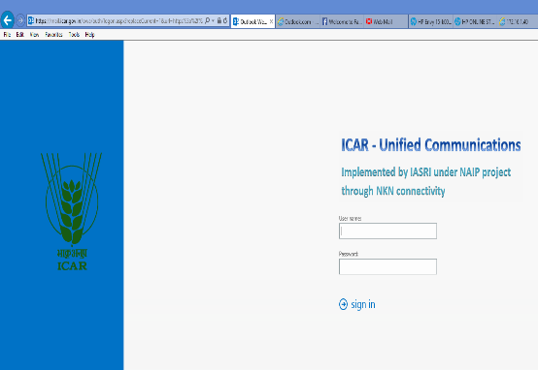
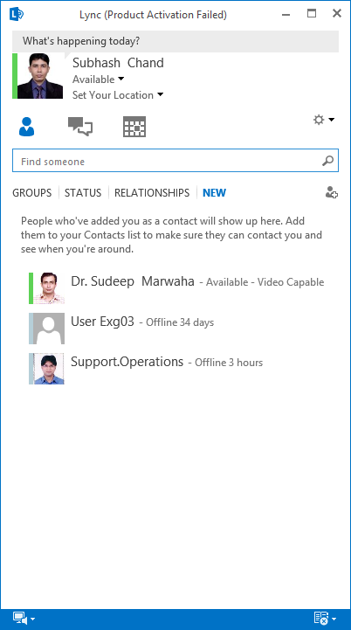
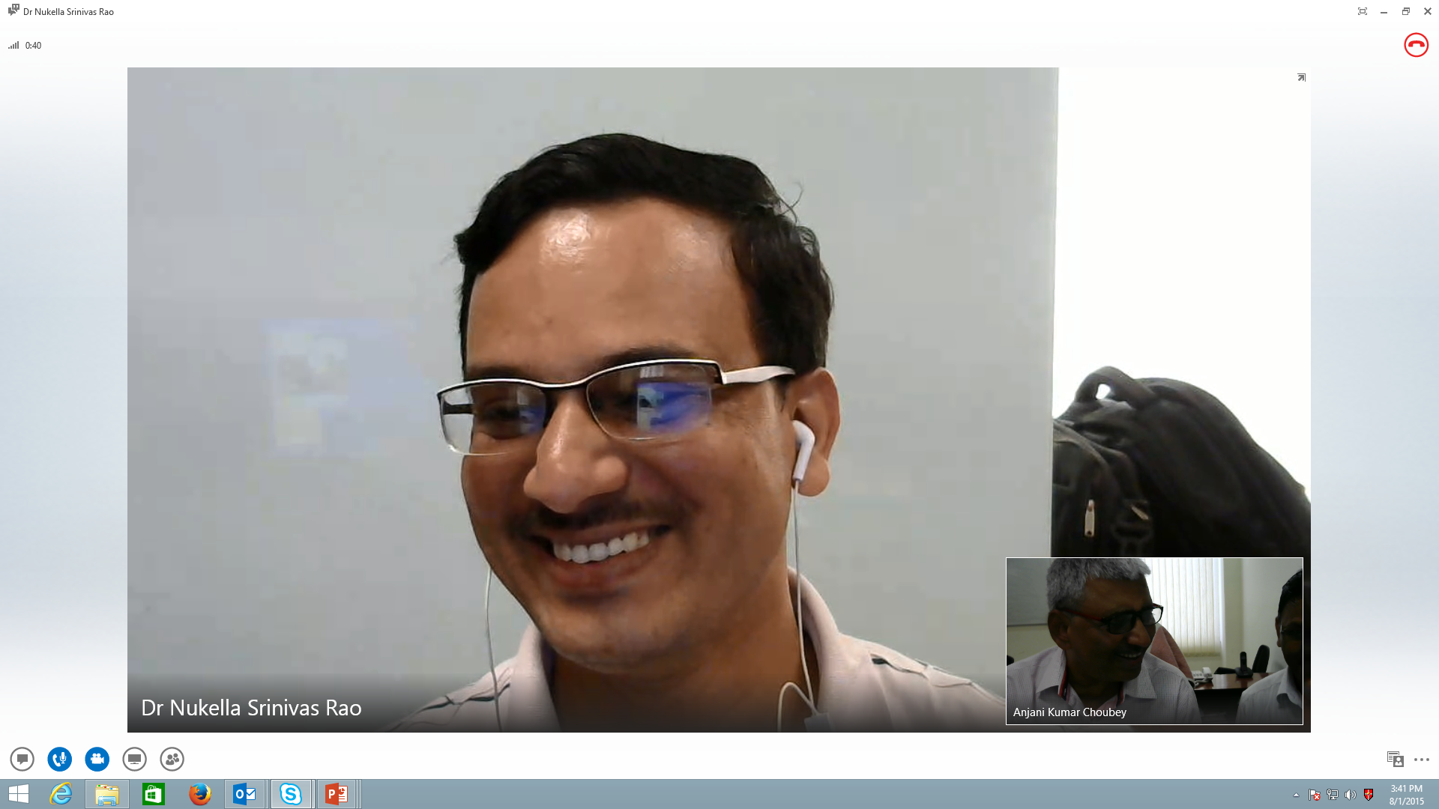
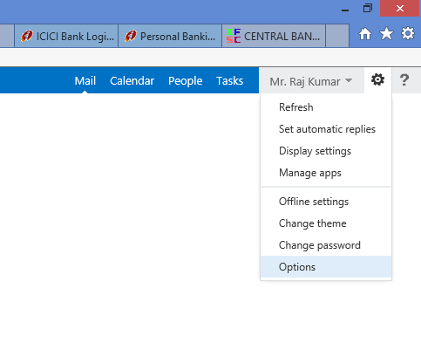
Unified Communication
Active Directory setup
Unified Communication solution for 15000 Lync users and 25000 email users

Slide 12
Status of Unified Communication Solution
No of Institutes:​ 110 (including ICAR Hq & ASRB)
Email created (No. of institutes) : 100
Total no. of Users : 11589
Active users : 3372
Idle users : 8217
Lync facilities given : 8462
Lync Active User : 169
Unified Communication Solution not given : 10
Reason​: Respective Institutes did not send the verified/complete data of their employees so far

Slide 13
Overview of KRISHI Portal Application
KRISHI Portal provides a platform to access information, avail services, collaborate and share knowledge.
KRISHI provides information and services to Beneficiaries (Internet Users - Farmers, Researchers, Students, NGOs associated with agriculture and other stakeholders) and Implementers (ICAR Institutions Users/Intranet Users) will be updating and using the information.
‘Single Sign On’ enables to log in once and able to access various applications as per their assigned role. Providing Role based access is part of application development.
Active Directory has been set up for authentication of Users to avail Email & Unified Communication services. The same id and password will be integrated for KRISHI Services to provide access to the Intranet Users.
Internet Users will access through login/ User Authentication module of each application to be hosted on KRISHI.

Slide 14
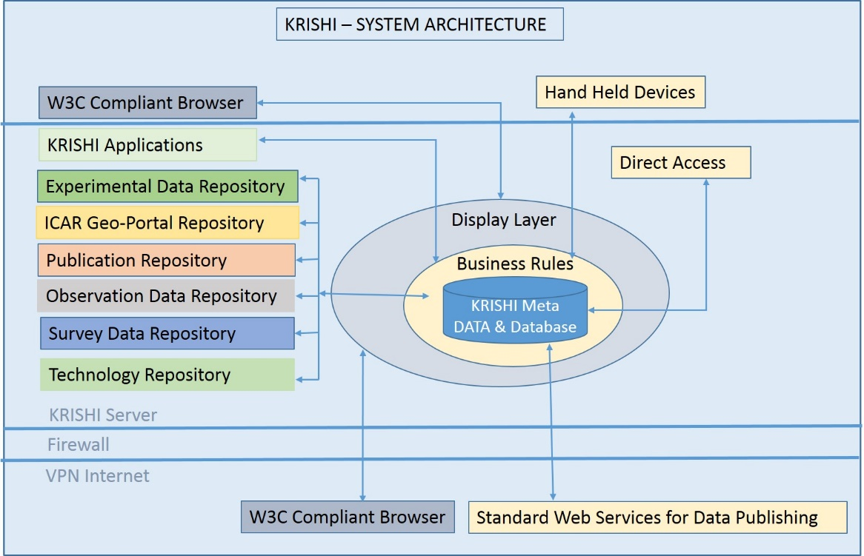
KRISHI Portal Application Archicture
Development of Applications using E-Governance standards/best practices
  W3C Architecture compliant
  Inter-Operability standard
  Meta Data of Database and Applications
  Web Guidelines by NIC,Deity
  Application Security Audit

Slide 15
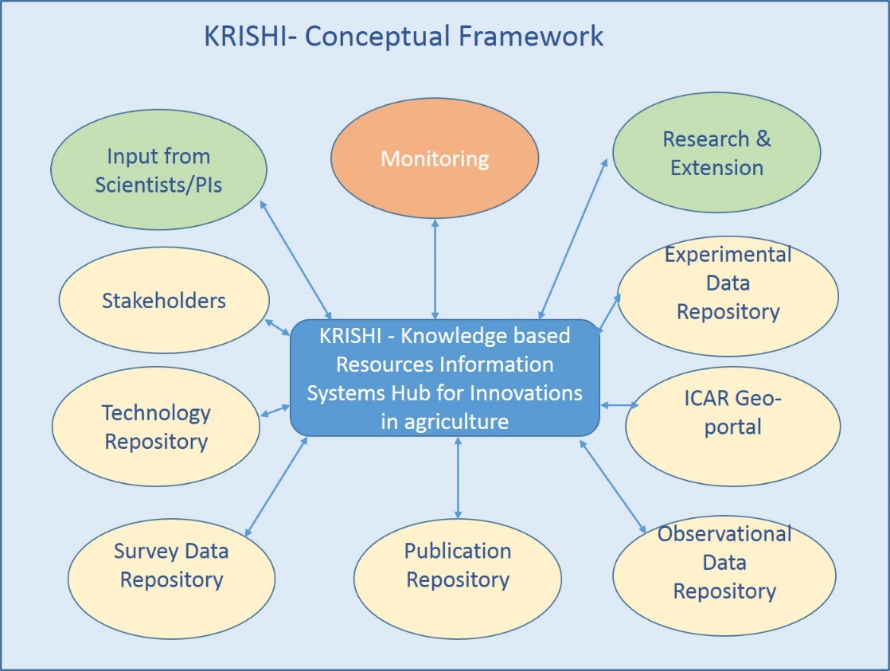

Slide 16
KRISHI Portal Application -Access
Authorised user will be allowed to view and update the data/information.
Access control would be effective in the senses that unauthorized user can access open (unrestricted)information.
Access control will be based on Role-Based Access Control (RBAC)
RBAC will be used to determine what role(s) a subject (User/Client) may perform.
After identify the user, the system will ensure that the user can only perform the role he/she is entitled to.
Administrator will assign the user to specific role on user request
Role hierarchies will be defined/given to reflect the responsibilities, authorities and competencies of groups with in the institute

Slide 17
Krishi Portal- Users
Administrator -
Administrator will have full control on the portal. It will monitor all the transactions on portal and generate all type of reports.
There are two type of user access
Internet applications users – Public user
Any user with access to KRISHI Portal who is not registered as ICAR personnel is a public-user. These users will have access to the open source information available on the portal.
Intranet Applications – Authentication user can access the information.
All ICAR personnel will be authenticated user.

Slide 18
KRISHI Portal
ADMINISTRATOR
Users
Authenticated-User
Public Users
Senior RMPs, ICAR
SMD Nodal Officers
Directors/HoDs
PME Cell I/C
Institute Nodal Officers
ICAR Scientists
User Structure for Krishi Portal

Slide 19
Nodal Officer – Uploading, View, Editing, Forward, report generation
PME Cell I/C - Uploading, View, Editing, report generation
HoD - Verify, View, Forward, Report generation
Director – Edit, View, Approve, Report Generation and Monitoring
Scientists –Enter Data, Edit, View and Upload Data
KRISHI Portal
SMD Nodal Officers - View, Report Generation & Monitoring
Public User –View Open Access Information
DG, DDG and ADG - View and Report Generation
Context Diagram for Role-Based Access Control

Slide 20
Scientists/PIs – Enter Data/Information
Work flow mechanism for Data/Information for Approval and publish the information on KRISHI portal
Head – Edit, Forwarded to Nodal Officer
No
Is Data/
Information
Correct?
Nodal Officer/PME Cell I/c of the Institute – View /Edit/check the information
Forwarded to Director for Approval
Yes
Is Approved by Director?
No
Yes
Notification to
SMD Nodal Officers
KRISHI PORTAL

Slide 21
Information Flow and Approve Procedure
Step 1- Primarily scientist/PIs will enter the information in specified format which is available online on Krishi Portal
Step 2- HoD will check, edit the data and forward to Nodal Officer/PME Cell In-charge
Step 3- Nodal Officer will verify the data as record available in PME Cell. If the data found correct then it will be forwarded to Director for Approval or in case of incorrect the data will be sent back to concerned scientists/PIs
Step 4- On the recommendation of PME Cell and Nodal Officer, Director will approve the data set for publishing on KRISHI portal as well as a notification will go to SMD Nodal Officer. In case Director does not approve then data will go back to Concerned scientists/PIs

Slide 22
Thank You

